Slide 1

BI Service final 001

Slide 2
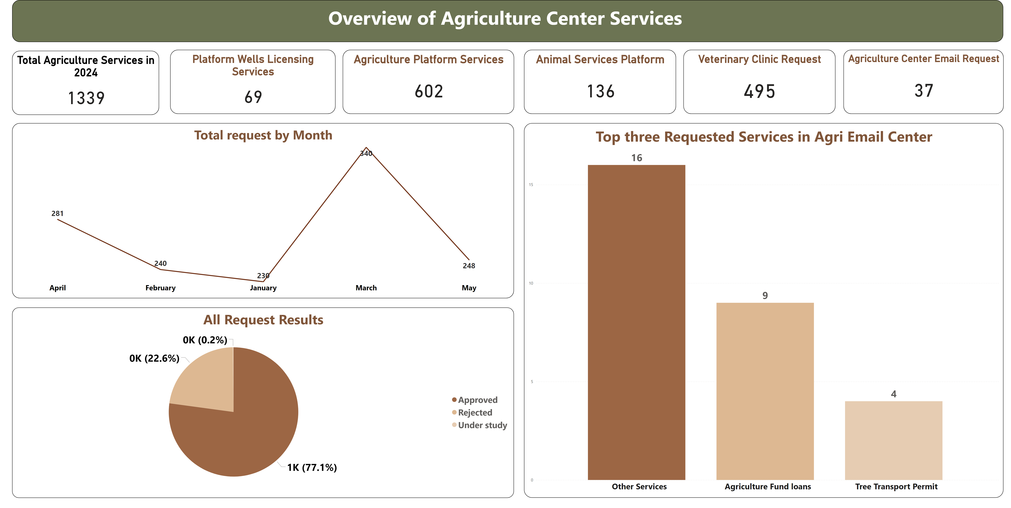
Overview of Agri Services
Notes:
Agriculture Platform Services
No alt text provided
Animal Services Platform
No alt text provided
Agriculture Center Email Request
No alt text provided
Platform Wells Licensing Services
No alt text provided
Veterinary Clinic Request
No alt text provided
Total Agriculture Services in 2024
No alt text provided
Top three Requested Services in Agri Email Center
No alt text provided
Total request by Month
No alt text provided
All Request Results
No alt text provided
textbox
No alt text provided

Slide 3
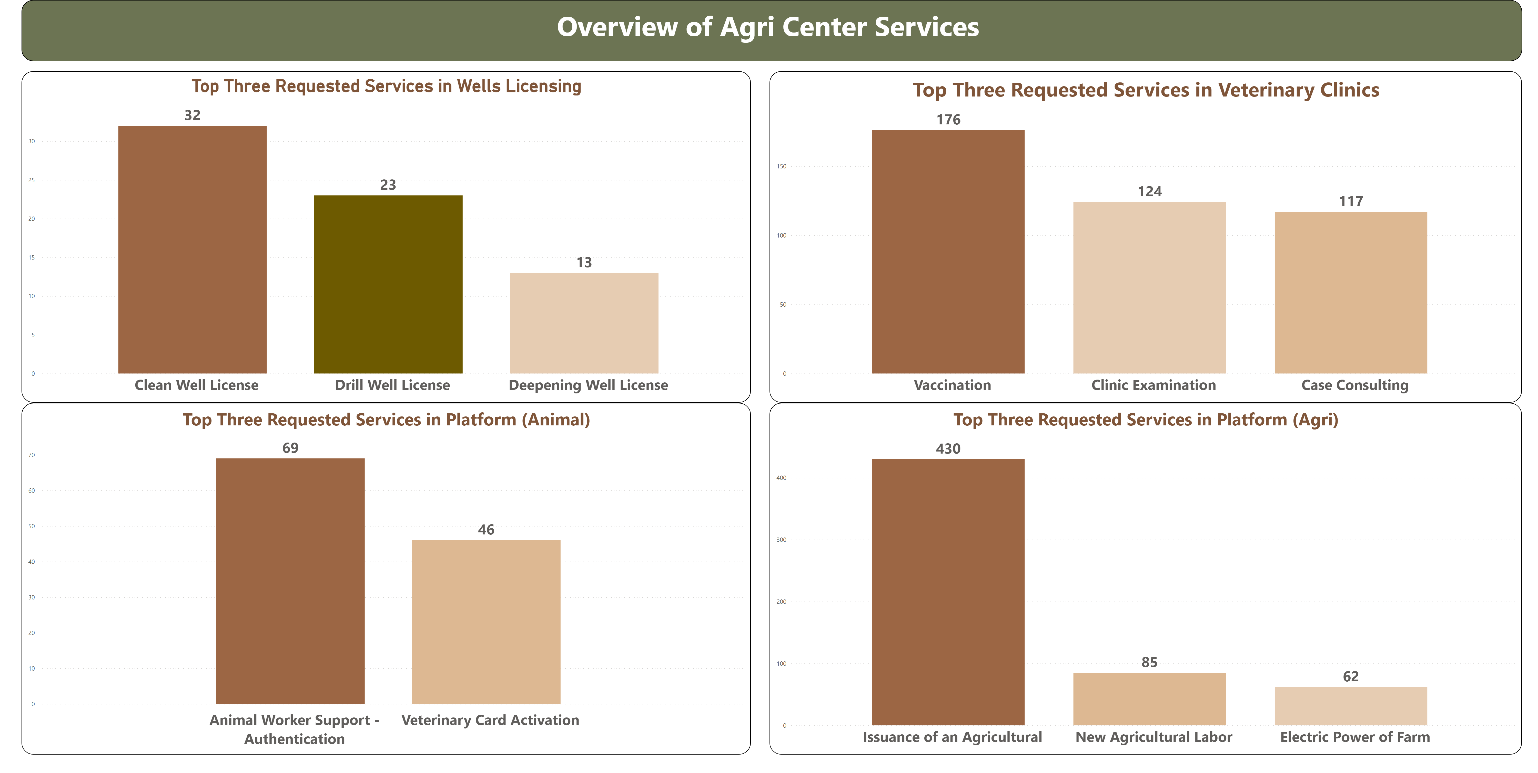
Overview of Agri Services 2
Notes:
Top Three Requested Services in Veterinary Clinics
No alt text provided
Top Three Requested Services in Wells Licensing
No alt text provided
Top Three Requested Services in Platform (Agri)
No alt text provided
Top Three Requested Services in Platform (Animal)
No alt text provided
textbox
No alt text provided

Slide 4
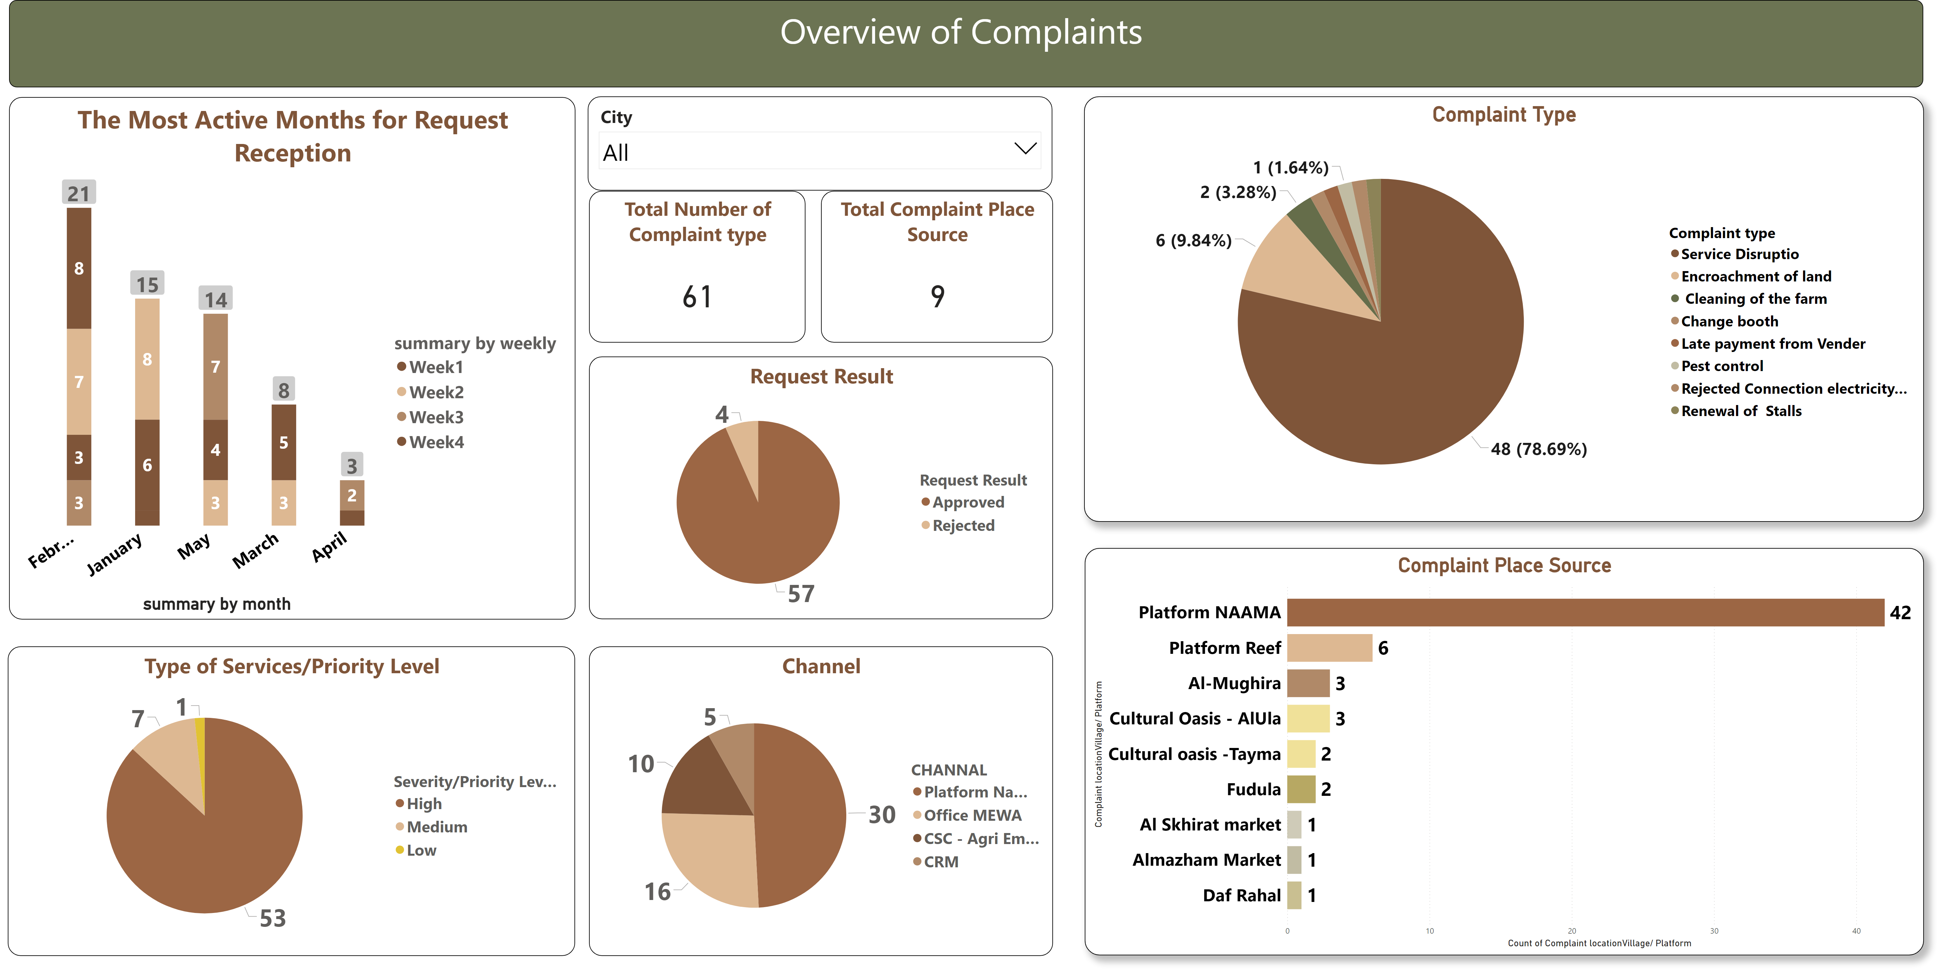
Overview of Complaints
Notes:
The Most Active Months for Request Reception
No alt text provided
textbox
No alt text provided
Channel
No alt text provided
Total Number of Complaint type
No alt text provided
Type of Services/Priority Level
No alt text provided
slicer
No alt text provided
Total Complaint Place Source
No alt text provided
Request Result
No alt text provided
Complaint Place Source
No alt text provided
Complaint Type
No alt text provided

Slide 5
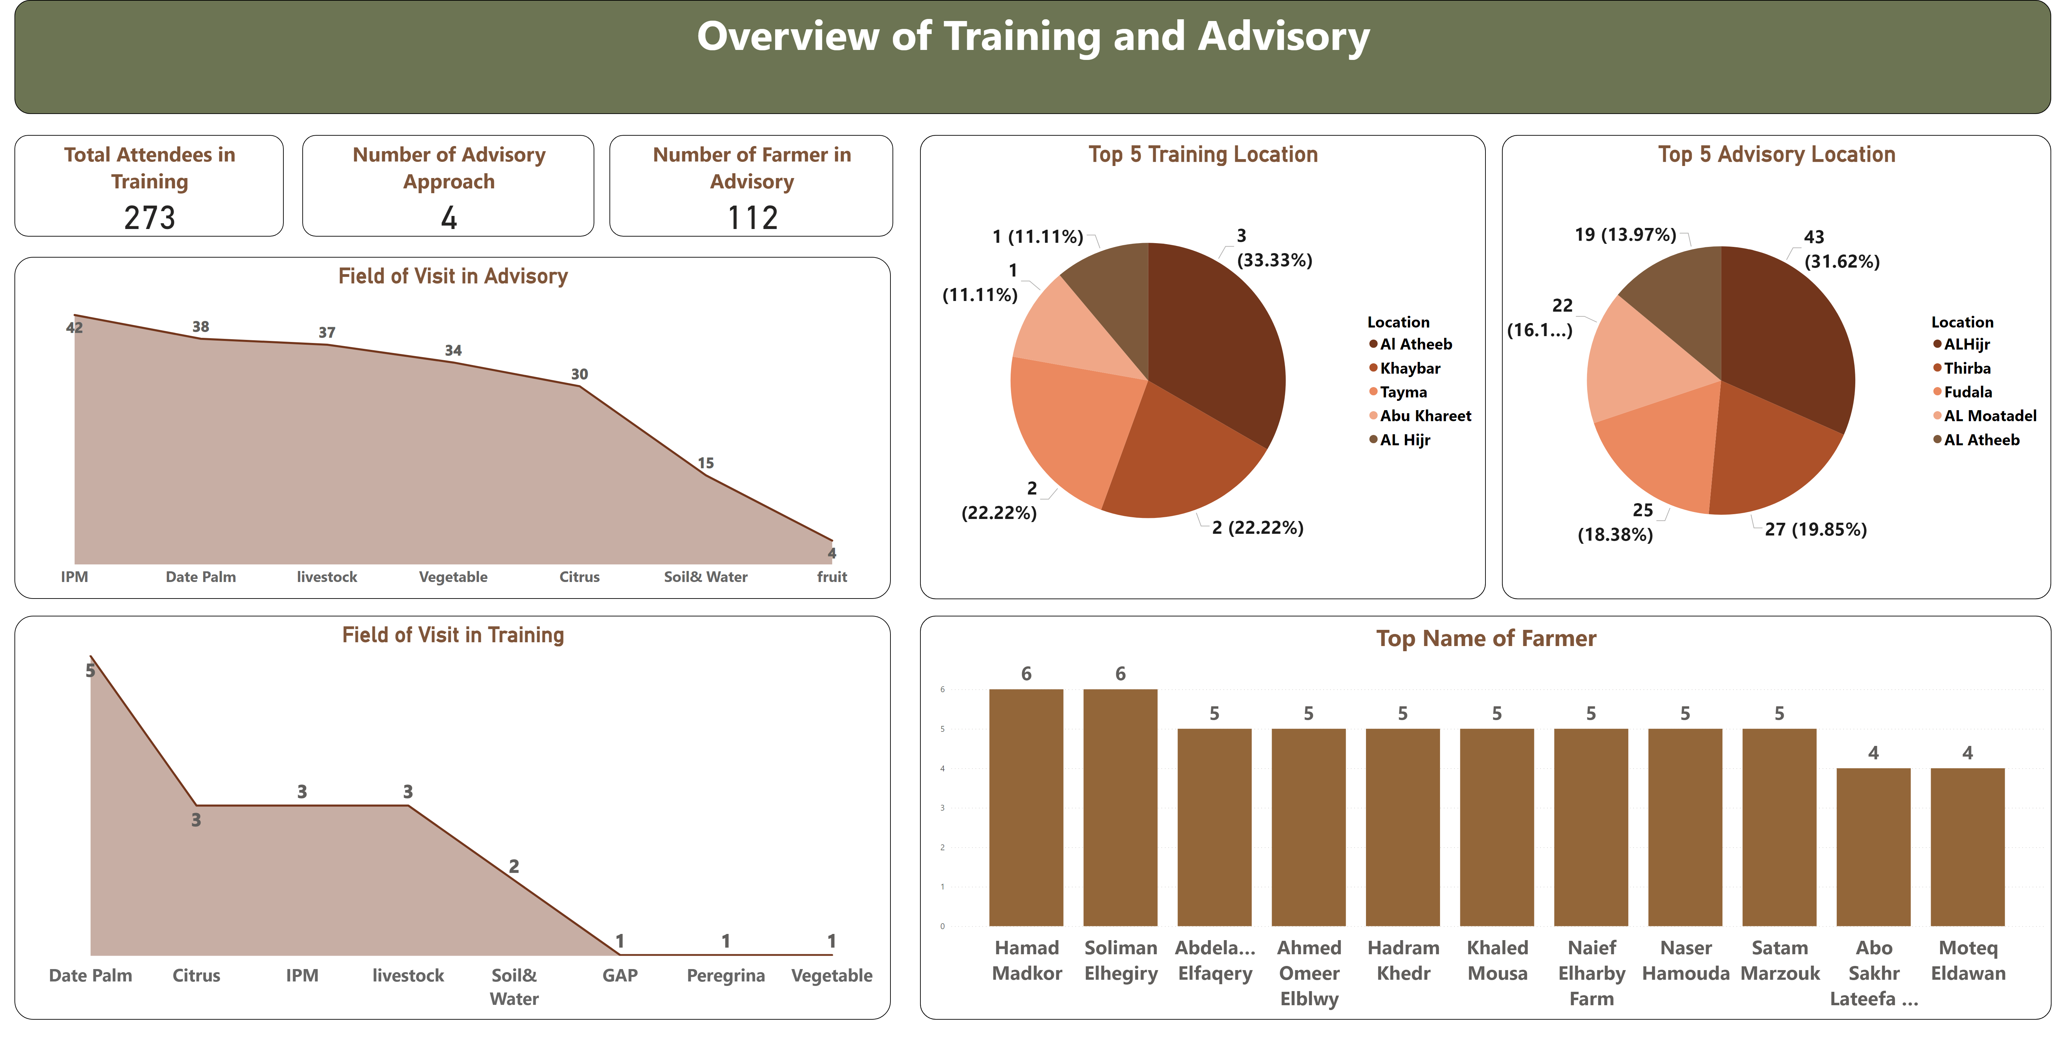
Overview of Training,Advisory
Notes:
Overview of Training and Advisory
No alt text provided
Field of Visit in Advisory
No alt text provided
Number of Advisory Approach
No alt text provided
Top Name of Farmer
No alt text provided
Total Attendees in Training
No alt text provided
Field of Visit in Training
No alt text provided
Number of Farmer in Advisory
No alt text provided
Top 5 Advisory Location
No alt text provided
Top 5 Training Location
No alt text provided

Slide 6
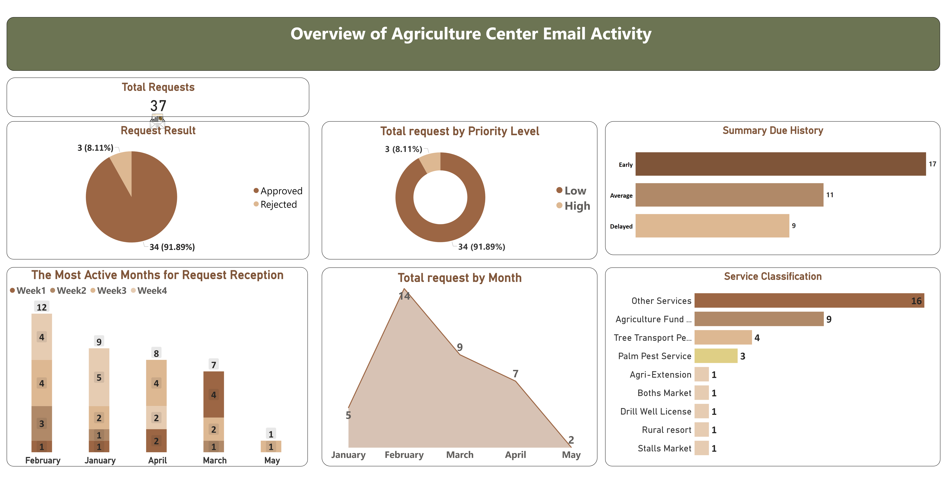
Agri Center Email (Orignal)
Notes:
Service Classification
No alt text provided
Total request by Month
No alt text provided
Summary Due History
No alt text provided
Total request by Priority Level
No alt text provided
image
No alt text provided
Total Requests
No alt text provided
The Most Active Months for Request Reception
No alt text provided
Request Result
No alt text provided
textbox
No alt text provided

Slide 7
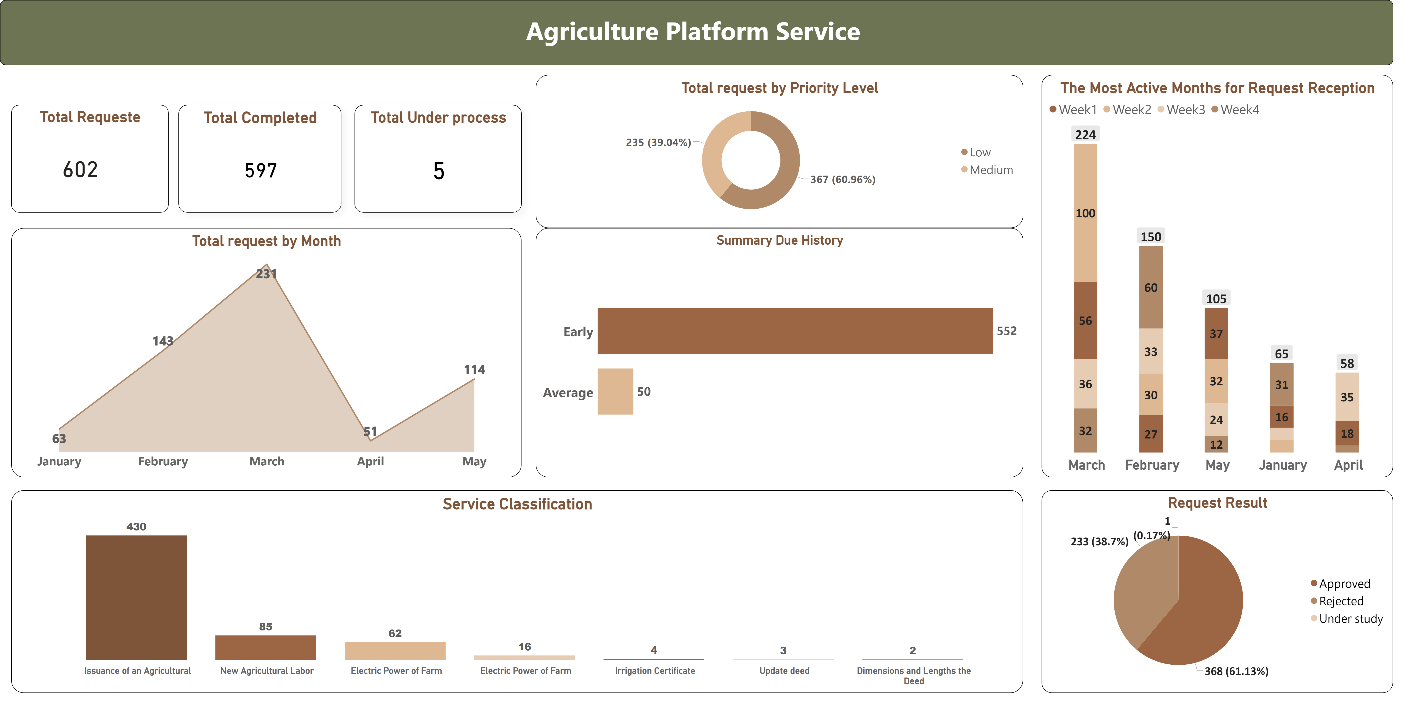
Platform (Agri)
Notes:
textbox
No alt text provided
Service Classification
No alt text provided
Total request by Month
No alt text provided
Summary Due History
No alt text provided
Total request by Priority Level
No alt text provided
Total Completed
No alt text provided
Total Requeste
No alt text provided
The Most Active Months for Request Reception
No alt text provided
card
No alt text provided
Total Under process
No alt text provided
Request Result
No alt text provided

Slide 8
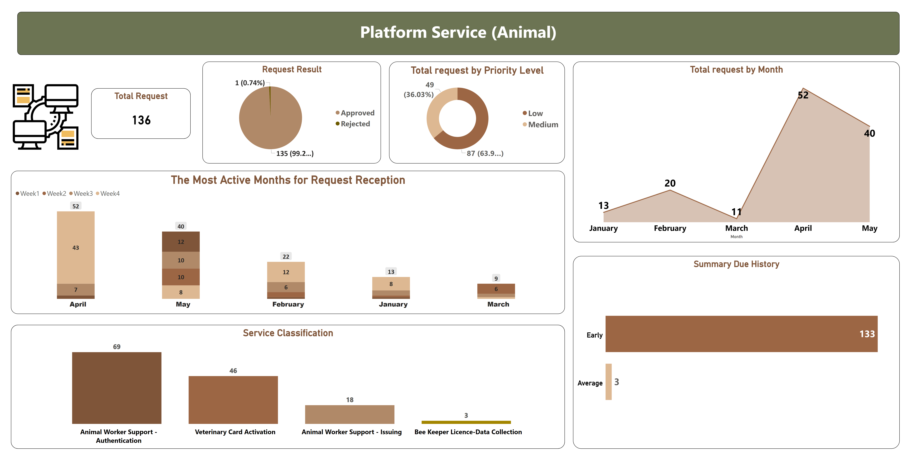
Platform (Animal)
Notes:
textbox
No alt text provided
Summary Due History
No alt text provided
Total Request
No alt text provided
Total request by Priority Level
No alt text provided
image
No alt text provided
The Most Active Months for Request Reception
No alt text provided
Request Result
No alt text provided
Total request by Month
No alt text provided
Service Classification
No alt text provided

Slide 9
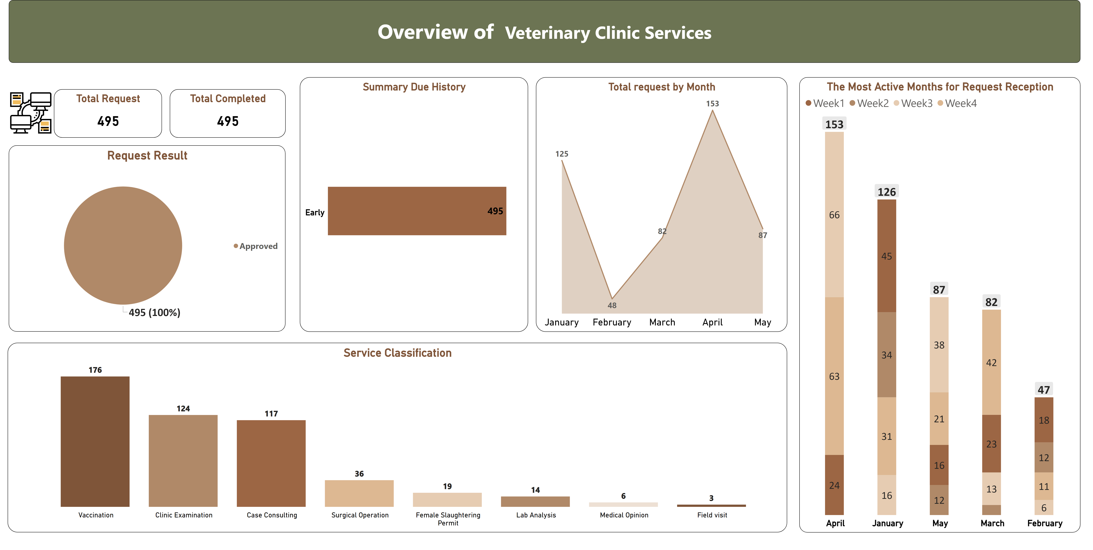
Veterinary Clinic Services
Notes:
textbox
No alt text provided
Service Classification
No alt text provided
Total request by Month
No alt text provided
Summary Due History
No alt text provided
textbox
No alt text provided
Total Completed
No alt text provided
image
No alt text provided
The Most Active Months for Request Reception
No alt text provided
Total Request
No alt text provided
Request Result
No alt text provided

Slide 10
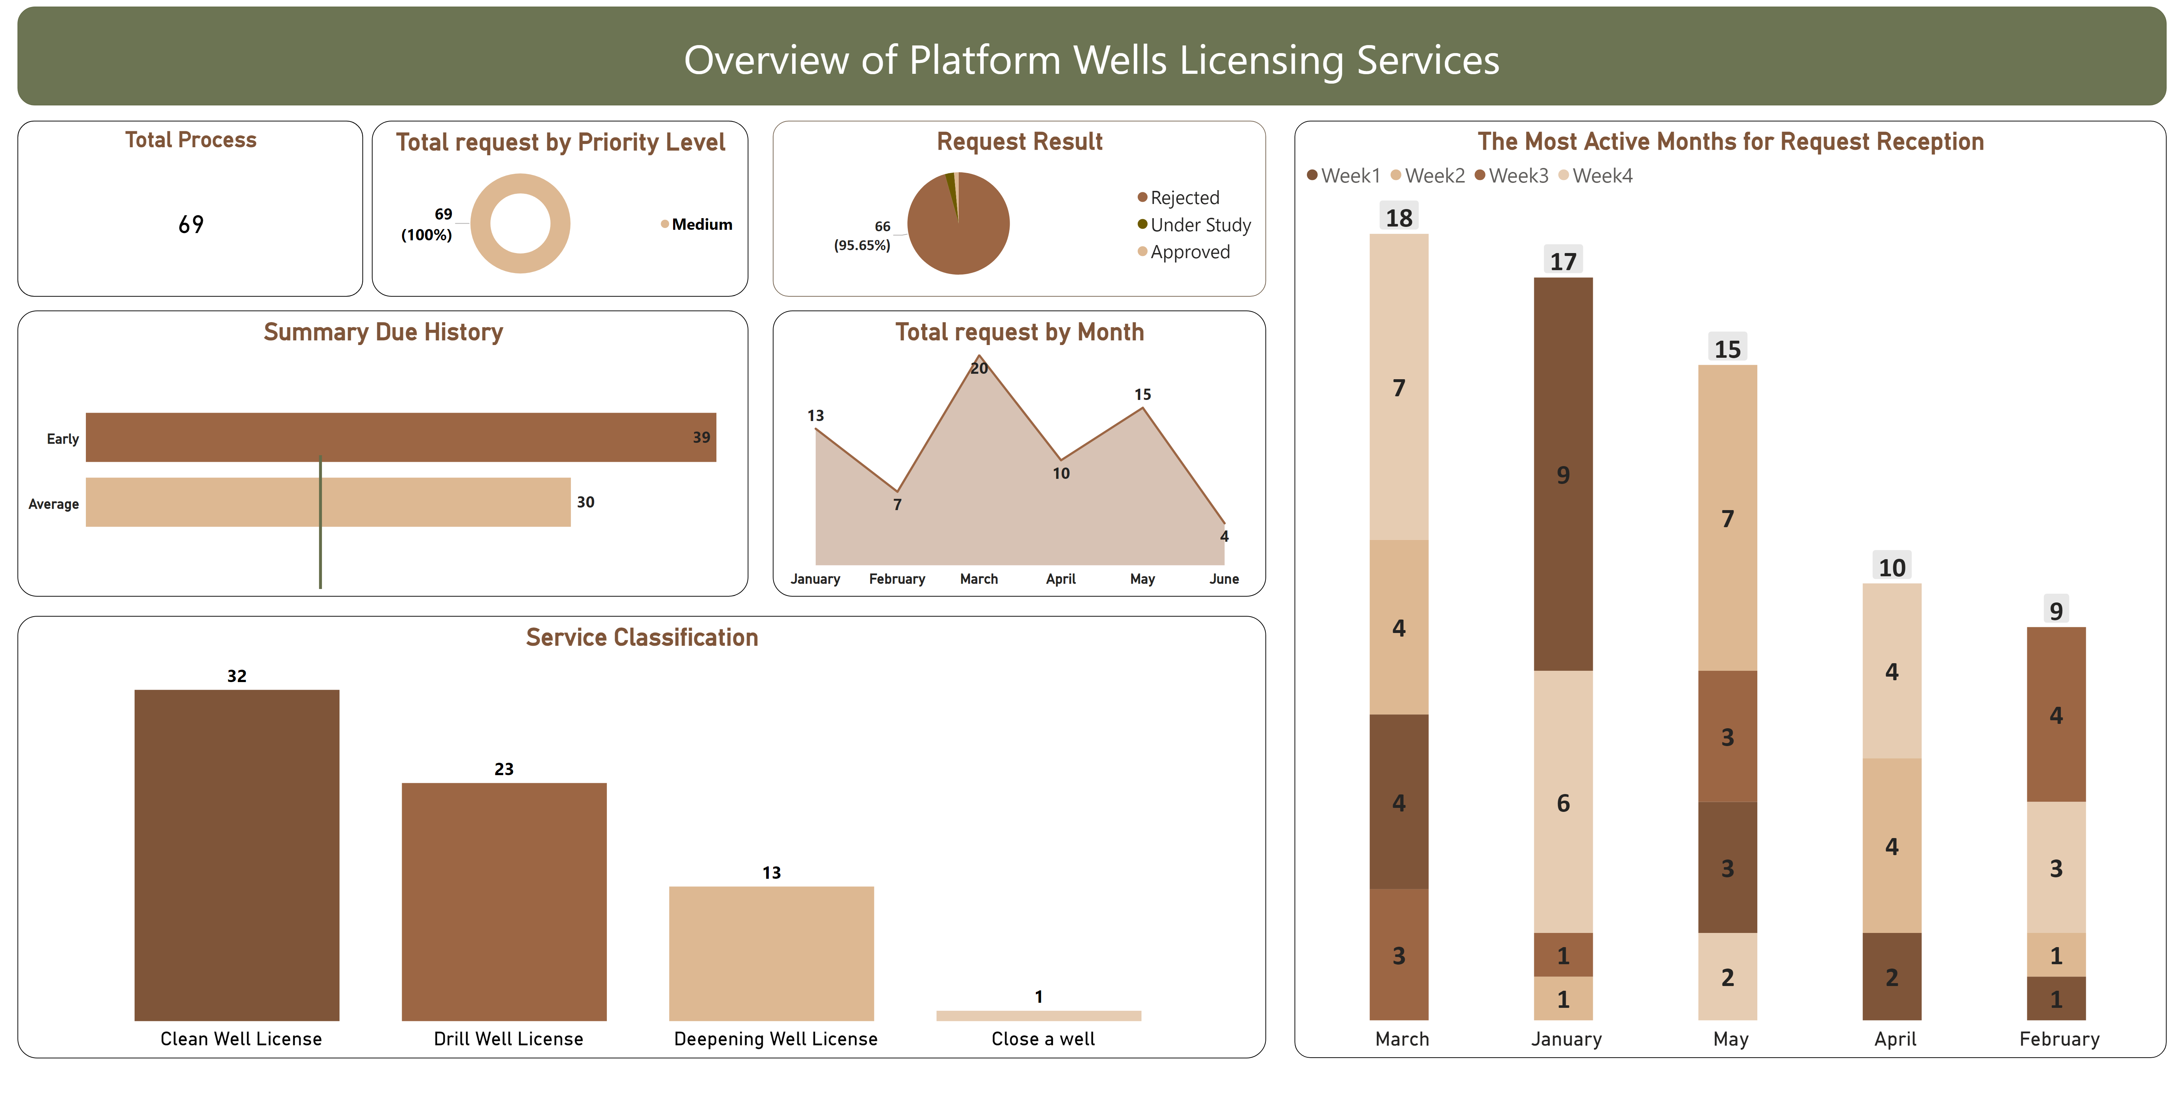
Wells Licensing Services
Notes:
textbox
No alt text provided
Service Classification
No alt text provided
Total request by Month
No alt text provided
Summary Due History
No alt text provided
Total request by Priority Level
No alt text provided
basicShape
No alt text provided
textbox
No alt text provided
The Most Active Months for Request Reception
No alt text provided
Total Process
No alt text provided
Request Result
No alt text provided

Slide 11
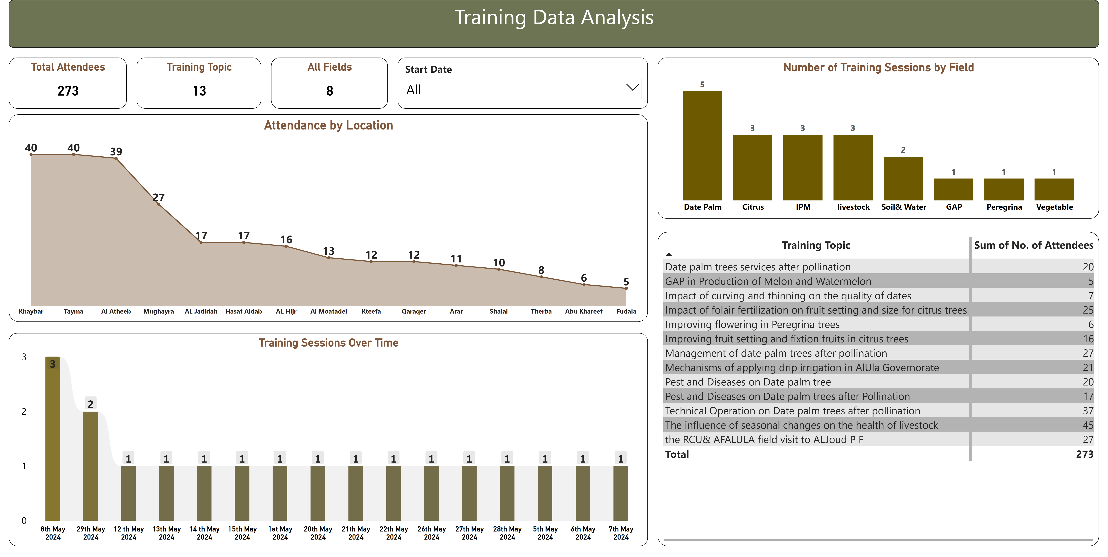
Training Analysis
Notes:
Training Data Analysis
No alt text provided
Number of Training Sessions by Field
No alt text provided
Attendance by Location
No alt text provided
Total Attendees
No alt text provided
Training Sessions Over Time
No alt text provided
tableEx
No alt text provided
Training Topic
No alt text provided
All Fields
No alt text provided
slicer
No alt text provided

Slide 12
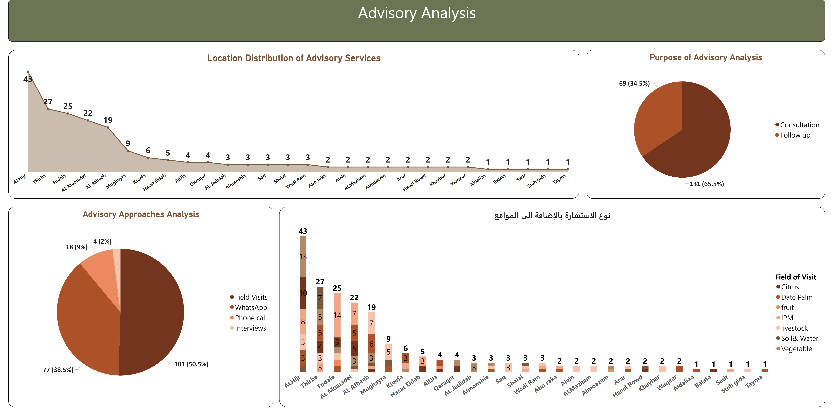
Advisory Analysis
Notes:
Location Distribution of Advisory Services
No alt text provided
Advisory Approaches Analysis
No alt text provided
Purpose of Advisory Analysis
No alt text provided
نوع الاستشارة بالإضافة إلى المواقع
No alt text provided
Advisory Analysis
No alt text provided

